Slide 1

Trapo Travel Assistance Chatbot
Presented By:- SHUBHAJIT BISWAS– Institute of Engineering and Management, Kolkata –CSE(AIML)

Slide 2
OUTLINE
Problem Statement
Proposed System/Solution
System Development Approach
Result
Conclusion
Future Scope
References

Slide 3
Problem Statement
In response to the evolving complexities of travel and the diverse needs of travelers worldwide, there exists a critical requirement for an intelligent and accessible solution integrated into ubiquitous communication platforms like WhatsApp. TraPo (Travel Partner) aims to address this need by serving as an advanced chatbot offering a range of services including destination recommendations, personalized travel advice, budget planning, ticket bookings, and coordination with local tour guides and service providers. Leveraging artificial intelligence and natural language processing, TraPo will provide real-time, tailored assistance to users, ensuring a seamless and responsive interaction experience. The project's objective is to develop TraPo into a versatile travel companion accessible to all segments of society, enhancing convenience and efficiency in travel planning through direct integration with WhatsApp for instant access to comprehensive travel-related information and services.

Slide 4
Proposed Solution
WhatsApp Integration: TraPo will be integrated as a chatbot within WhatsApp, leveraging its vast user base and accessibility. Users can initiate conversations with TraPo directly through WhatsApp, making it convenient and familiar for global travelers.
Feature Set: TraPo will offer a comprehensive range of services through its AI-powered chatbot interface:-
Destination Recommendations: Based on user preferences (such as interests, budget, and travel dates), TraPo will suggest suitable travel destinations worldwide.
Personalized Travel Advice: Users can receive personalized tips and advice tailored to their specific travel plans and interests.
Budget Planning: TraPo will assist users in planning their travel budgets, providing estimates for accommodation, transportation, and activities based on real-time data and user inputs.
Ticket Bookings: Integration with ticket booking services will enable users to book flights, trains, and other transportation options directly through the chatbot.

Slide 5
Coordination with Local Services: TraPo will facilitate connections with local tour guides, accommodation providers, and service agencies, ensuring seamless coordination and bookings.
Real-time Assistance: Using natural language processing, TraPo will provide instant responses to user queries and updates on travel-related information.
3. User Experience: TraPo aims to enhance the user experience by:- Offering a conversational interface that feels intuitive and responsive.
Providing 24/7 availability, catering to users in different time zones and travel emergencies.
Ensuring privacy and security of user information through WhatsApp's encryption protocols.
4. Scalability and Accessibility: TraPo will be designed to accommodate users from all segments of society, including those with varying levels of technical proficiency. The chatbot's interface will be user-friendly, minimizing the learning curve for new users.
5. Technological Foundation: Leveraging artificial intelligence and machine learning algorithms, TraPo will continuously improve its recommendations and services based on user interactions and feedback. This adaptive approach ensures that the chatbot remains relevant and efficient over time.
6. Partnerships and Integration: Collaborations with travel agencies, service providers, and local businesses will enrich TraPo's capabilities, offering users a wider range of options and services

Slide 6
System Approach
The "System Approach" section outlines the overall strategy and methodology for developing and implementing the TraPo(Travel Partner Assistance chatbot). Here's a suggested structure for this section:
System requirements : it can be accessed by any kind of smart device having the latest WhatsApp Version installed in the system or Version 2.23.12.75
Library required to build the model : IBM Watsonx assistant

Slide 7
Result
TraPo (Travel Partner), an intelligent chatbot integrated with WhatsApp to streamline travel planning. Utilizing AI and natural language processing, TraPo will offer personalized destination recommendations, travel advice, budget planning, ticket bookings, and coordination with local services. This integration with WhatsApp aims to provide users instant, tailored assistance for enhanced convenience and efficiency in travel planning, making TraPo a versatile travel companion accessible to all

Slide 8
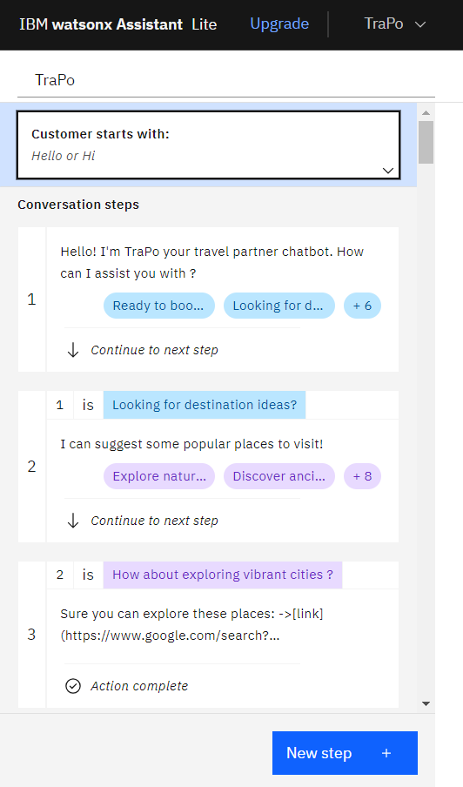
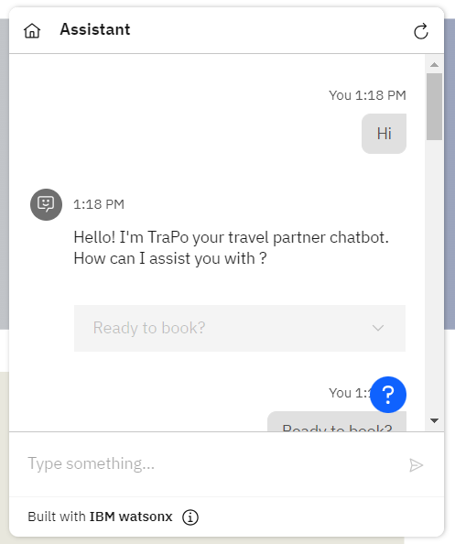
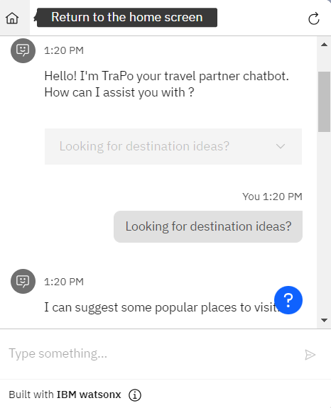
Result

Slide 9
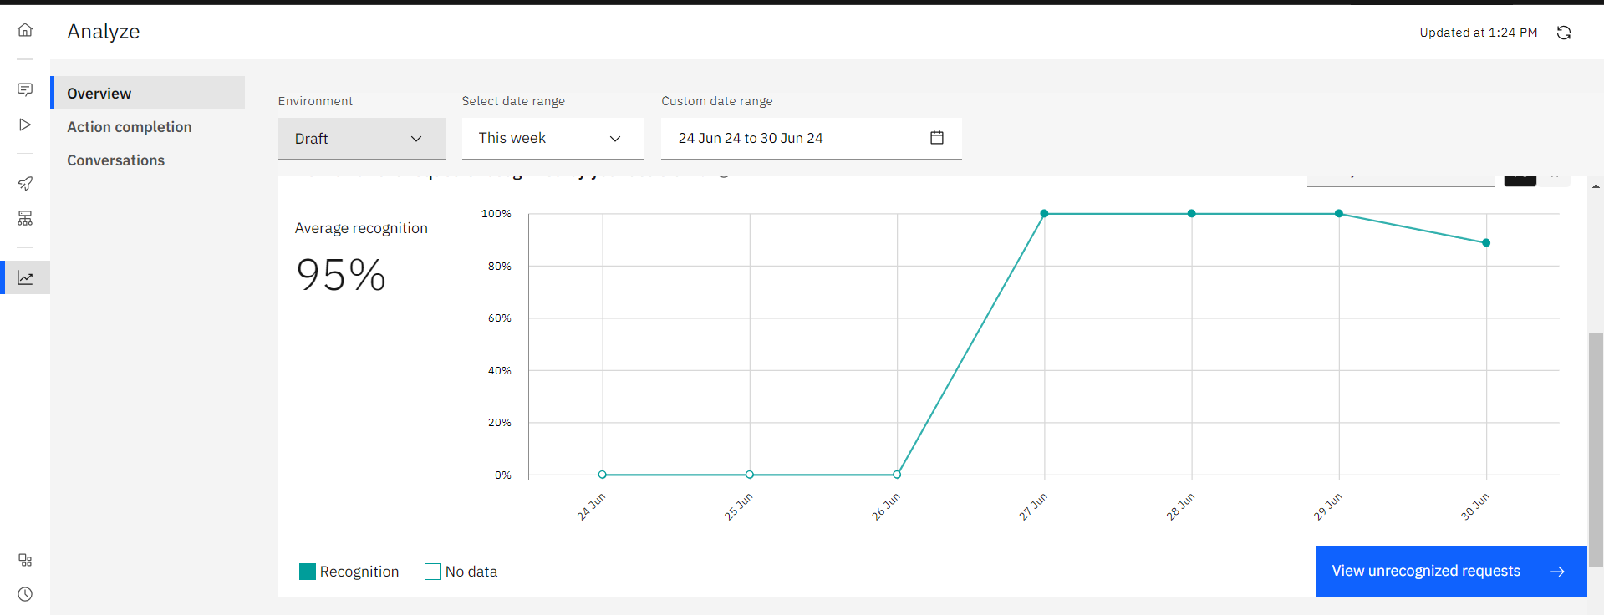
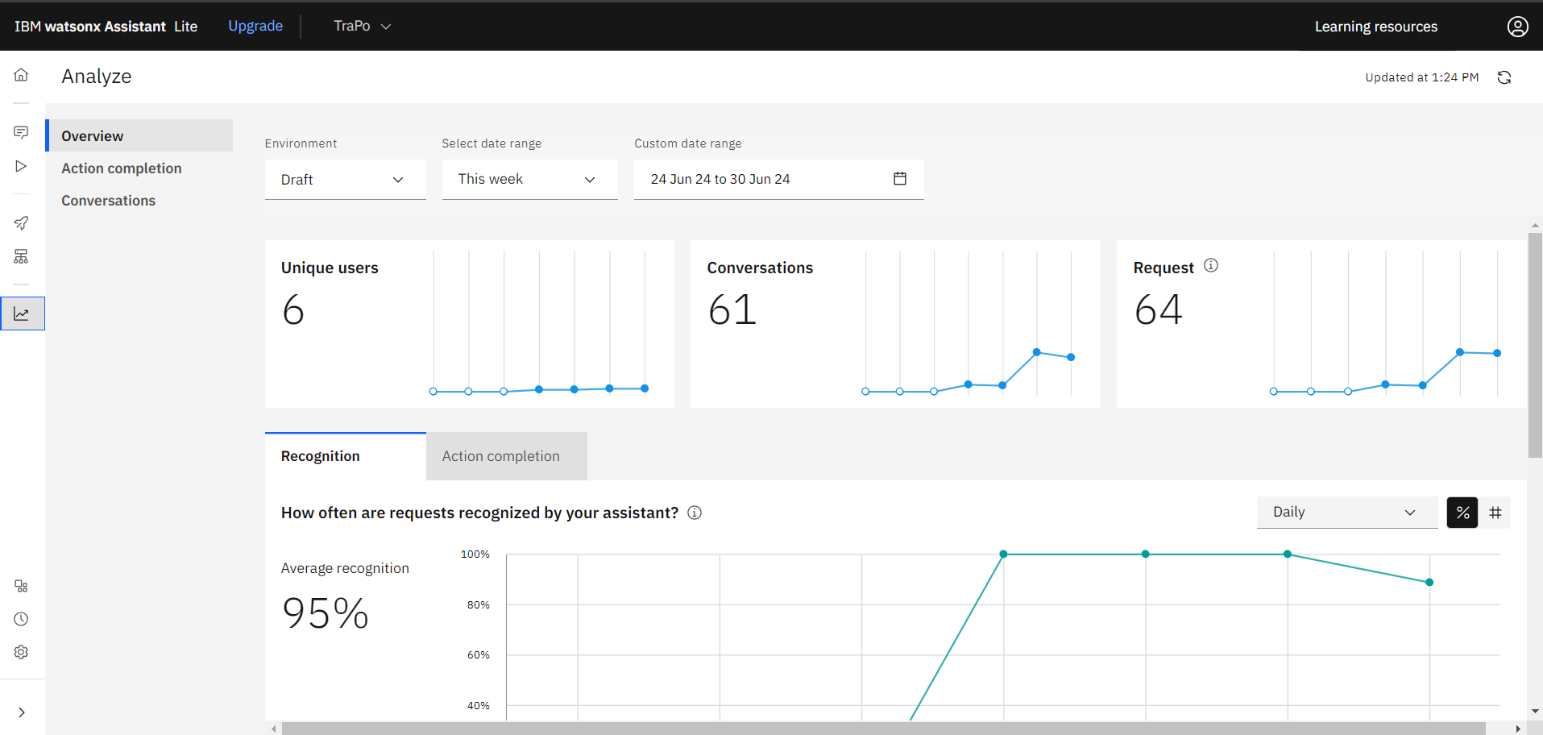

Slide 10
Conclusion
TraPo (Travel Partner) represents a pioneering solution poised to redefine travel planning through its integration with WhatsApp. By leveraging artificial intelligence and natural language processing, TraPo offers personalized recommendations, real-time assistance, and seamless coordination with local services, enhancing convenience and efficiency for travelers worldwide. The project's objective is to establish TraPo as a comprehensive travel companion accessible to diverse segments of society, ensuring a responsive and intuitive interaction experience that simplifies every aspect of travel from destination discovery to booking and exploration.

Slide 11
Future scope
Looking ahead, the future scope for TraPo includes expanding its capabilities and reach to further enhance the travel experience. This could involve:
1. Enhanced AI Capabilities: Continuously improving AI algorithms to provide more accurate and personalized recommendations based on user preferences and feedback.
2. Integration with More Platforms: Beyond WhatsApp, integrating TraPo with other popular messaging platforms and travel apps to reach a wider audience.
3. Multi-language Support: Adding support for multiple languages to cater to global travelers more effectively.
4. Advanced Booking Features: Introducing advanced features for booking complex travel itineraries, accommodations, and activities seamlessly through the chatbot.

Slide 12
5. Augmented Reality (AR) and Virtual Reality (VR) Integration: Implementing AR/VR technologies to offer virtual tours of destinations and immersive travel experiences.
6. Community and Social Integration: Incorporating social features where users can share travel experiences, tips, and recommendations with each other.
7. Accessibility Features: Ensuring accessibility for users with disabilities by incorporating features like voice commands and text-to-speech capabilities.
8. Data Security and Privacy: Strengthening data security measures to protect user information and maintain trust.
9. Partnership Expansion: Collaborating with more travel service providers, airlines, hotels, and local businesses to offer a broader range of services and exclusive deals.
10. User Feedback and Iteration: Continuously gathering user feedback to iterate and improve TraPo’s features, ensuring it remains a valuable and indispensable tool for travelers worldwide.
By focusing on these areas, TraPo can evolve into a comprehensive and indispensable travel companion that meets the diverse needs of travelers while maintaining simplicity and accessibility through innovative technology.

Slide 13
References
IBM watsonx Assistant tutorial
Google
ChatGPT
LinkedIn

Slide 14
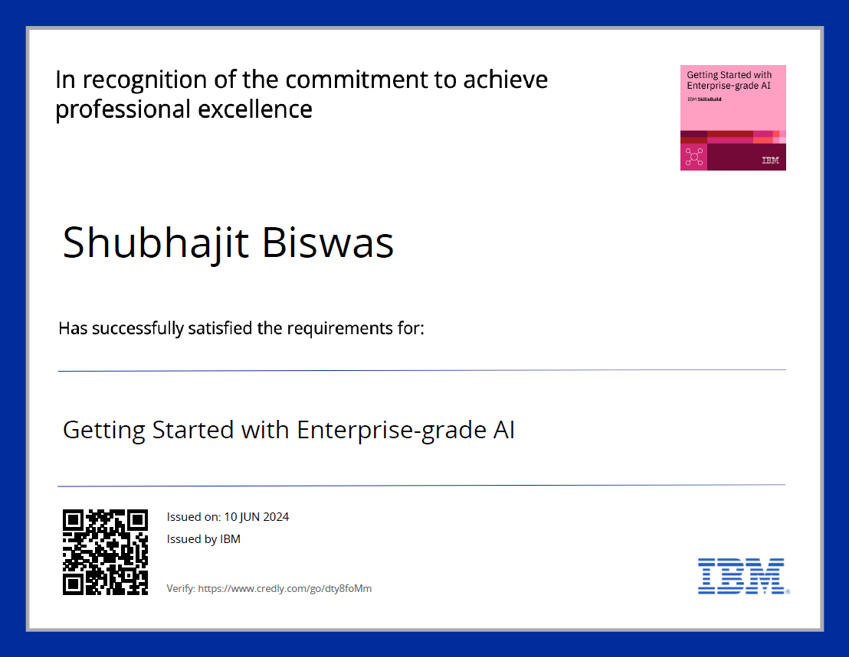
course certificate 1

Slide 15
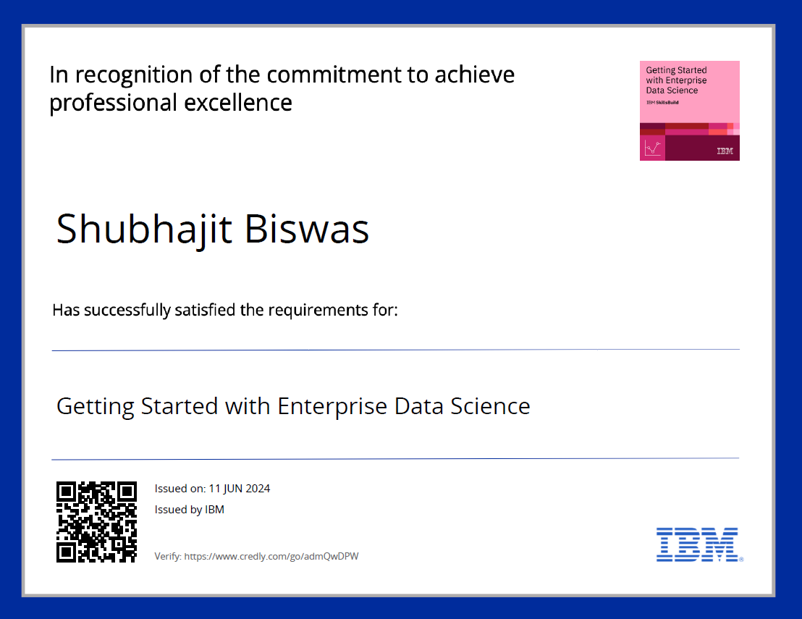
course certificate 2

Slide 16
THANK YOU

